Slide 1
Quality Circles & FISHBONE

Slide 2
GROUP MEMBERS
MUHAMMAD TAIMOOR
SHAHZAIB IDREES
SYED ISMAIL SHAH

Slide 3
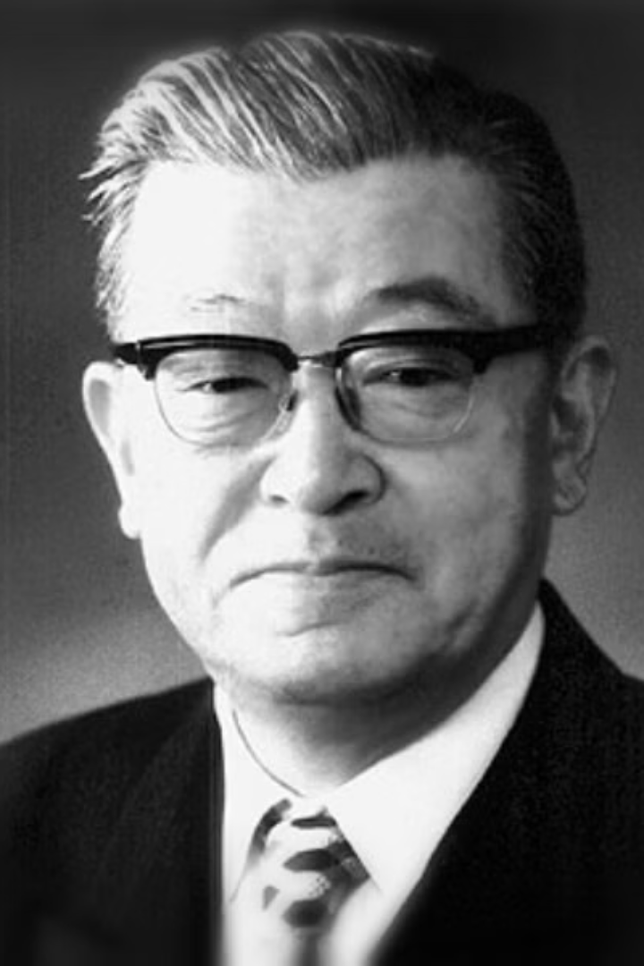
Kaoru Ishikawa: A Quality Revolution
This presentation explores the revolutionary concepts of quality circles and the fishbone diagram, developed by Dr. Kaoru Ishikawa, a pioneer in quality management.

Slide 4
What are Quality Circles?
Empowered Teams
Collaborative Problem-Solving
Small, voluntary groups of employees from the same work area, united by a shared passion for quality.
Quality circles identify, analyze, and solve quality problems within their own work processes, empowering employees to drive improvement.

Slide 5
How Quality Circles Work
Formation
1
Employees form small, self-managed groups, typically led by a facilitator.
2
Training
Members receive training on quality principles, problem-solving techniques, and communication skills.
Problem Identification
3
Circles identify and prioritize quality issues within their work areas.
4
Data Collection
They gather data to understand the problem, analyze trends, and identify potential causes.
Solution Development
5
Circles brainstorm and develop solutions to address the identified issues, focusing on root causes.
6
Implementation
They implement the agreed-upon solutions, monitoring progress and making adjustments as needed.
Presentation
7
Circles present their findings and solutions to management, seeking approval and support.
8
Evaluation
They evaluate the effectiveness of the implemented solutions and identify areas for further improvement.

Slide 6



The Role of Quality Circles in Business and Engineering
Manufacturing
Software Development
Engineering
Identify and resolve defects in production processes, improve product quality, and reduce waste.
Enhance code quality, reduce bugs, improve user experience, and increase software reliability.
Optimize product designs, improve manufacturing processes, and ensure products meet quality standards.

Slide 7

Key Benefits of Implementing Quality Circles
1
2
Increased Productivity
Enhanced Quality
Reduced defects and improved processes contribute to higher productivity.
Focus on quality leads to improved products and services, meeting customer expectations.
3
4
Improved Employee Morale
Reduced Costs
Empowered employees feel valued, leading to higher job satisfaction and increased engagement.
Fewer defects and improved efficiency result in lower production costs.

Slide 8

The Fishbone Diagram: Visualizing Root Causes

Slide 9





Step-by-Step Process of Creating a Fishbone Diagram
Define the Problem
1
Clearly articulate the quality issue or defect you want to analyze.
2
Main Cause
Draw a horizontal line representing the problem, pointing towards the right.
3
Major Categories
Draw diagonal lines branching off the main line, representing the potential cause categories.
4
Specific Causes
Brainstorm specific causes for the problem within each category.
5
Analysis and Solutions
Analyze the diagram to identify root causes and develop solutions.

Slide 10

Importance of Quality Circles and the Fishbone Diagram
Employee Engagement
Problem-Solving Efficiency
Empowers employees to take ownership of quality, boosting morale and motivation.
The structured approach of the fishbone diagram helps identify root causes, leading to effective solutions.
Continuous Improvement
Quality circles foster a culture of continuous improvement, driving innovation and progress within organizations.

Slide 11




Real-World Examples and Case Studies
Organizations like Toyota, General Electric, and Siemens have successfully implemented quality circles, achieving significant improvements in quality, productivity, and customer satisfaction.

Slide 12

Ask Anything…

